Slide 1

BALL·E
By Alessio Petrone & Silas Leuenberger

Slide 2
Idea Recap

Slide 3
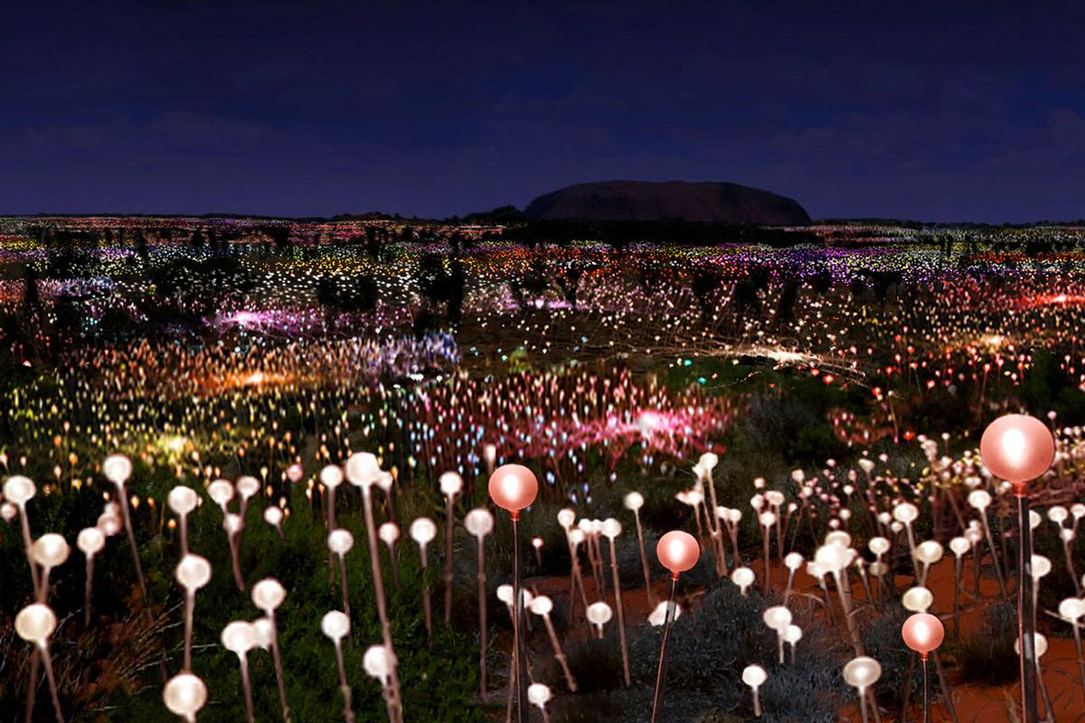
Imagine
Sea of little lights
Notes:
Sea of lights: https://www.leisureopportunities.com/images/HIGH9320_36194.jpg

Slide 4
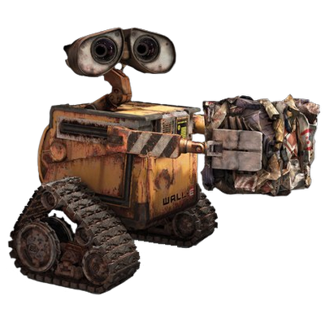
Imagine
Sea of little lights
Sad little robot
Collects a light
Throws it into the air
Repeats
Notes:
Wall-e: https://adda.io/blog/2011/02/waste-recycling-for-apartments-what/

Slide 5
Hope
Fireflies
Shooting Stars
Hope through lights
Lightshow
Lights flying through the air
Notes:
Shooting Stars: https://starwalk.space/de/news/tips-for-watching-meteor-showers
Fireflies: https://at.wetter.com/videos/nachrichten/leuchten-in-der-nacht-gluehwuermchen-sorgen-fuer-spektakel/6807920ce31ed40f140d5f63

Slide 6
Dramaturgy
Sisyphos
Wall-E
Suffering
Endless Cycle
Hope gives it a twist
Notes:
Wall-e: https://celebrationspress.com/2024/01/07/10-things-you-may-not-know-about-wall-e/
Sysiphos: https://griechische-mythologie.fandom.com/wiki/Sisyphos

Slide 7
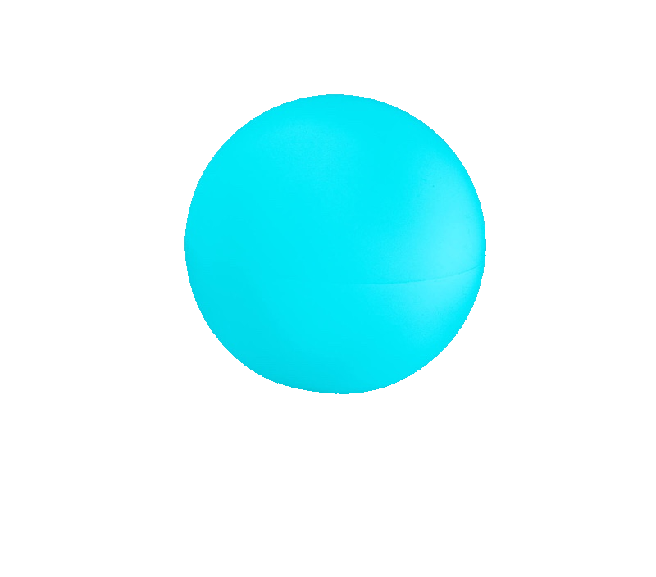
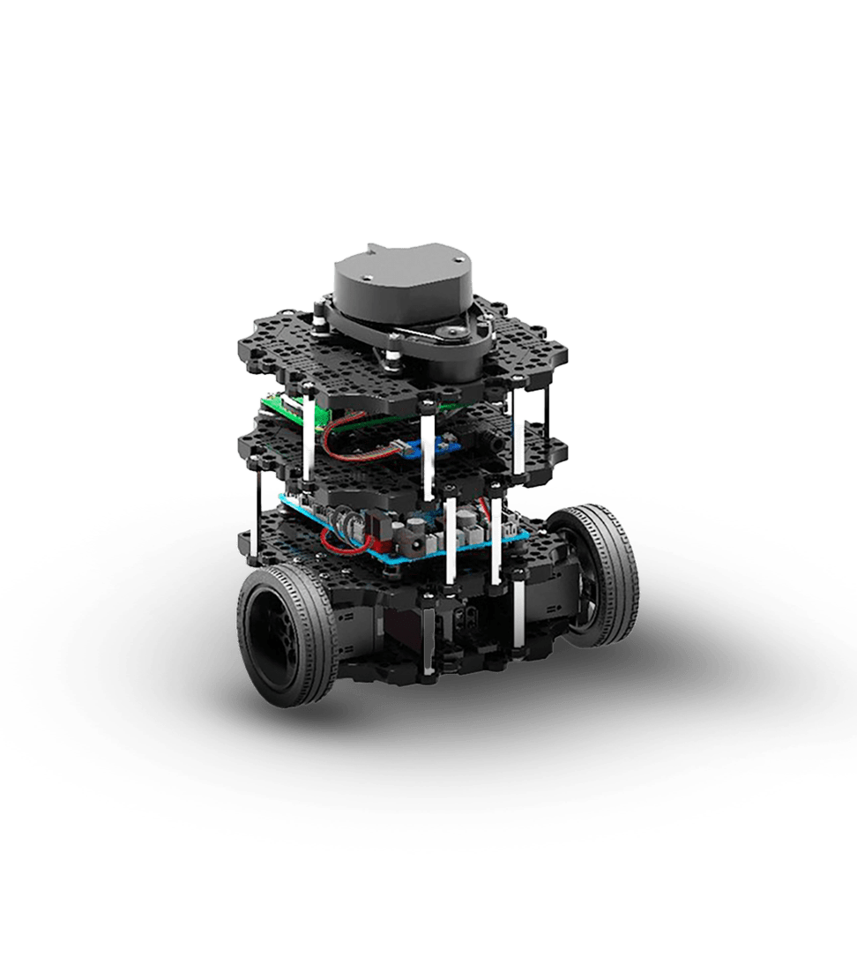
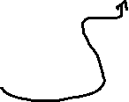


Idea
Propulses light into the air
Collects a light
Automatically moves to a light
Notes:
Turtlebot3: https://robotican.net/turtlebot-open-source-personal-research-robot-2/
Light ball: https://www.cerf-volant.ch/magasin/jonglerie_contact/index.php?main_page=product_info&cPath=1_201&products_id=2179&language=de

Slide 8
Sneak Peek

Slide 9
Propulsion And Collection
IDEA

Slide 10
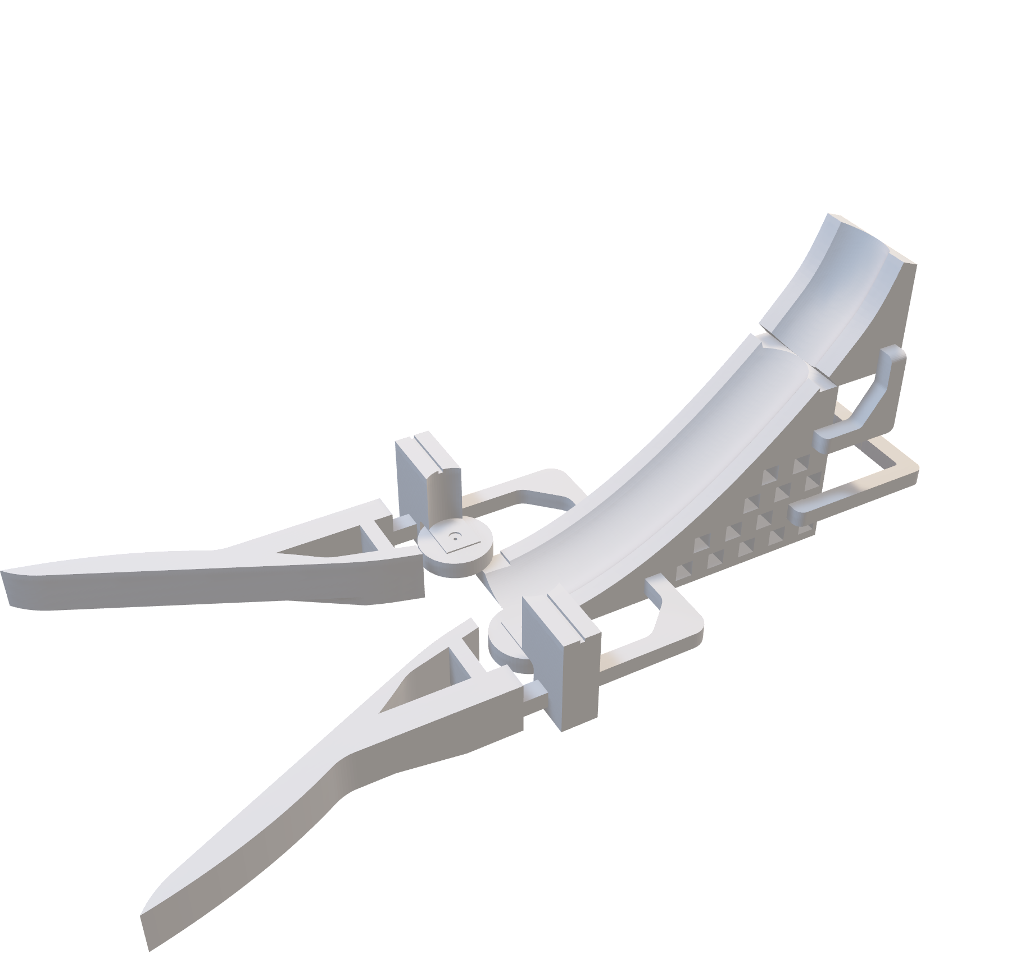

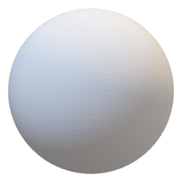


Idea
Funnel
LED-Ball

Slide 11



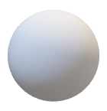
Idea
Ramp
DC-Motor
Holders

Slide 12


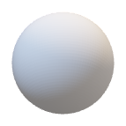
Idea
Ramp Extension
Connection to Turtlebot3

Slide 13
Propulsion And Collection
Main Development points

Slide 14
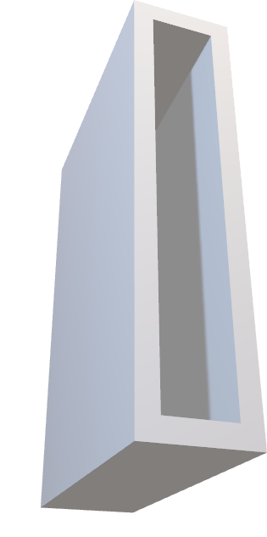
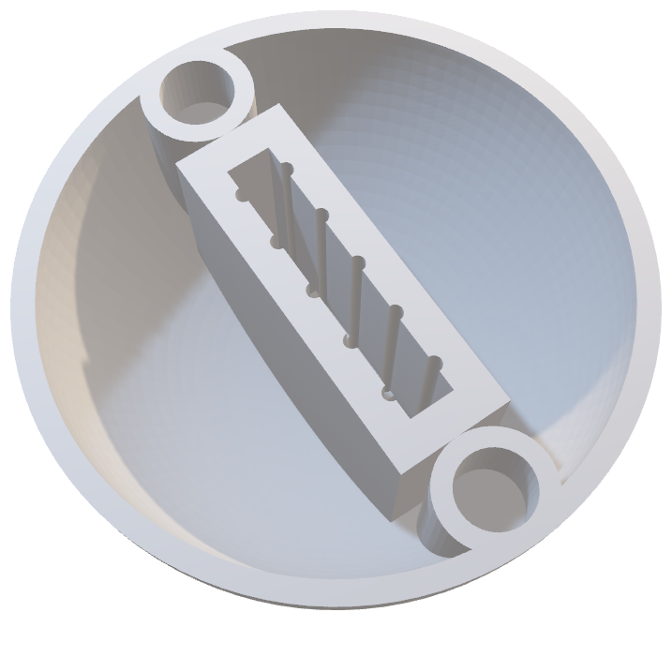
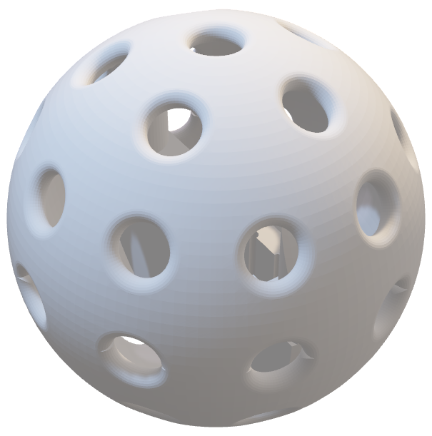
LED-bALL
Coin-Battery Holder
Test size first
Add LED pin cutouts
Ball Halves
Connect with dowel
Holes
Replace with transparent filament

Slide 15
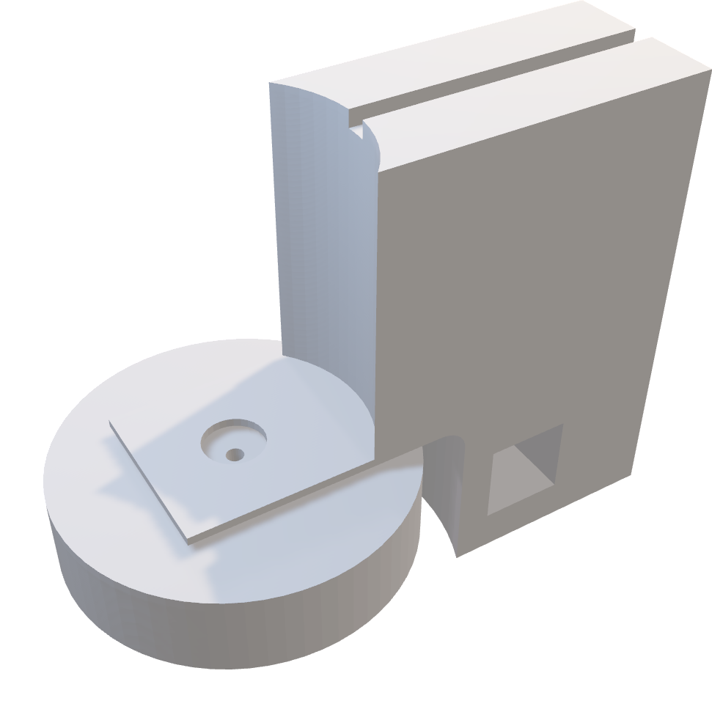
DC-Motors
Create Holders

Slide 16
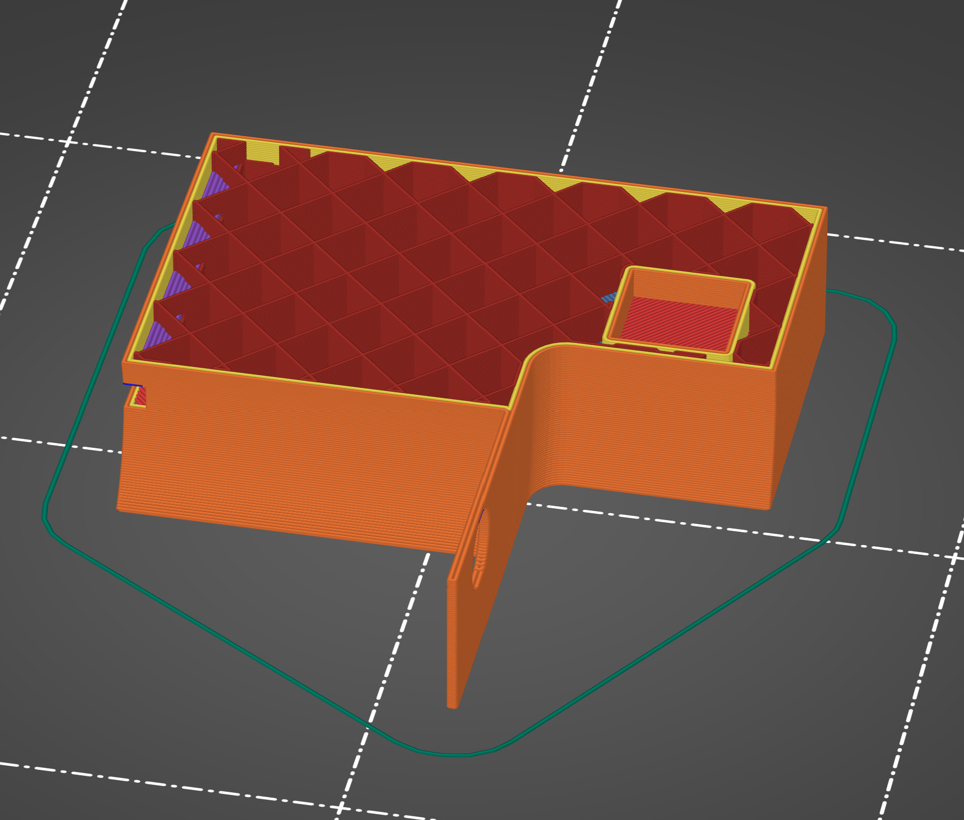
DC-Motors
Create Holders
Print sideways for stability

Slide 17
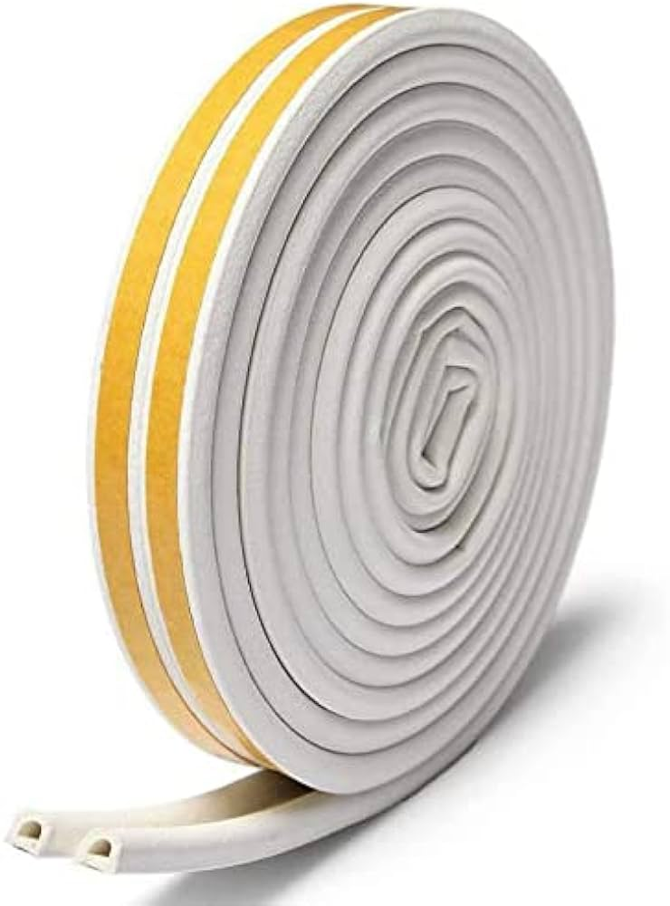
DC-Motors
Create Holders
Print sideways for stability
Wheels
Rubber isolation band for better grip
Notes:
Rubberband: https://m.media-amazon.com/images/I/41lVyRh2knL._AC_UF894,1000_QL80_.jpg

Slide 18
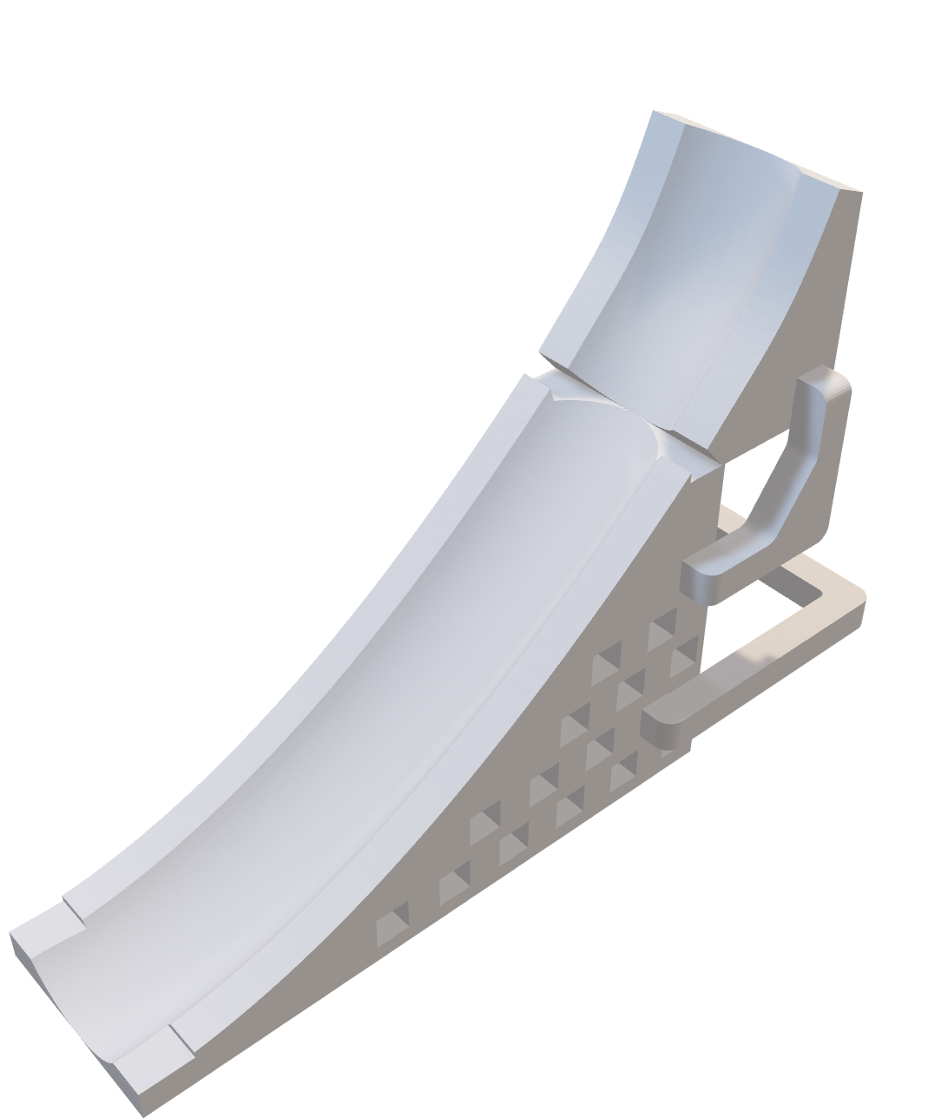
Ramp
Steepness
Too steep
Exit angle
Too flat
Make modifiable
Connect to Turtlebot3

Slide 19

Ramp
Steepness
Too steep
Exit angle
Too flat
Make modifiable
Connect to Turtlebot3

Slide 20

Ramp
Steepness
Too steep
Exit angle
Too flat
Make modifiable
Connect to Turtlebot3

Slide 21
Ramp
Steepness
Too steep
Exit angle
Too flat
Make modifiable
Connect to Turtlebot3

Slide 22

Ramp
Steepness
Too steep
Exit angle
Too flat
Make modifiable
Connect to Turtlebot3

Slide 23
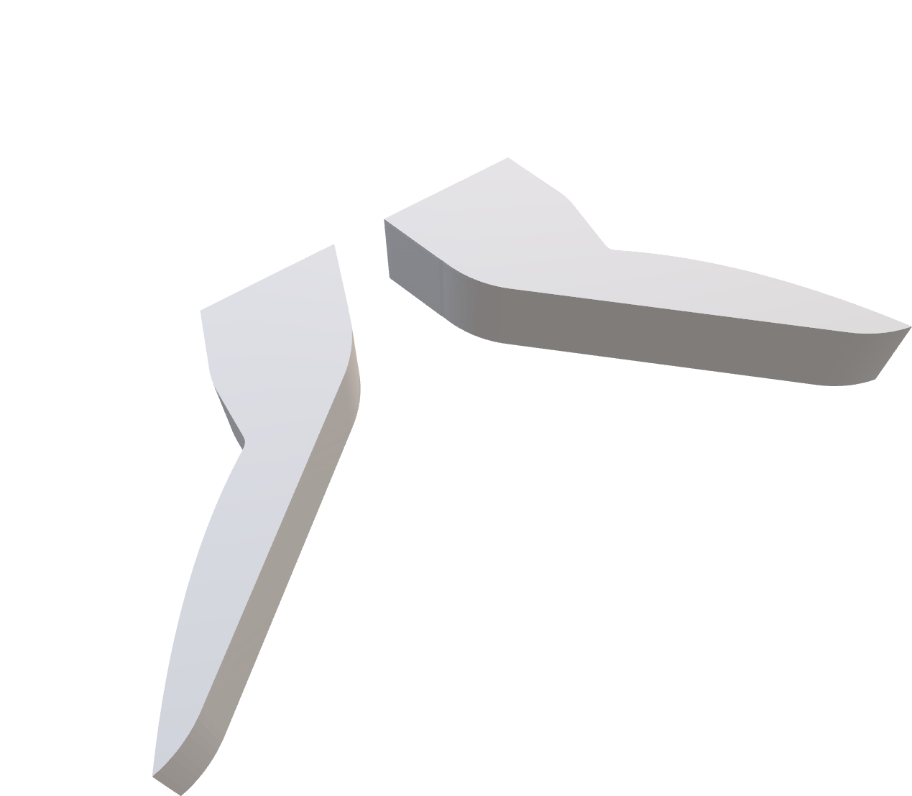
Funnel
Size
Too wide
Opening angle
Slim it down

Slide 24
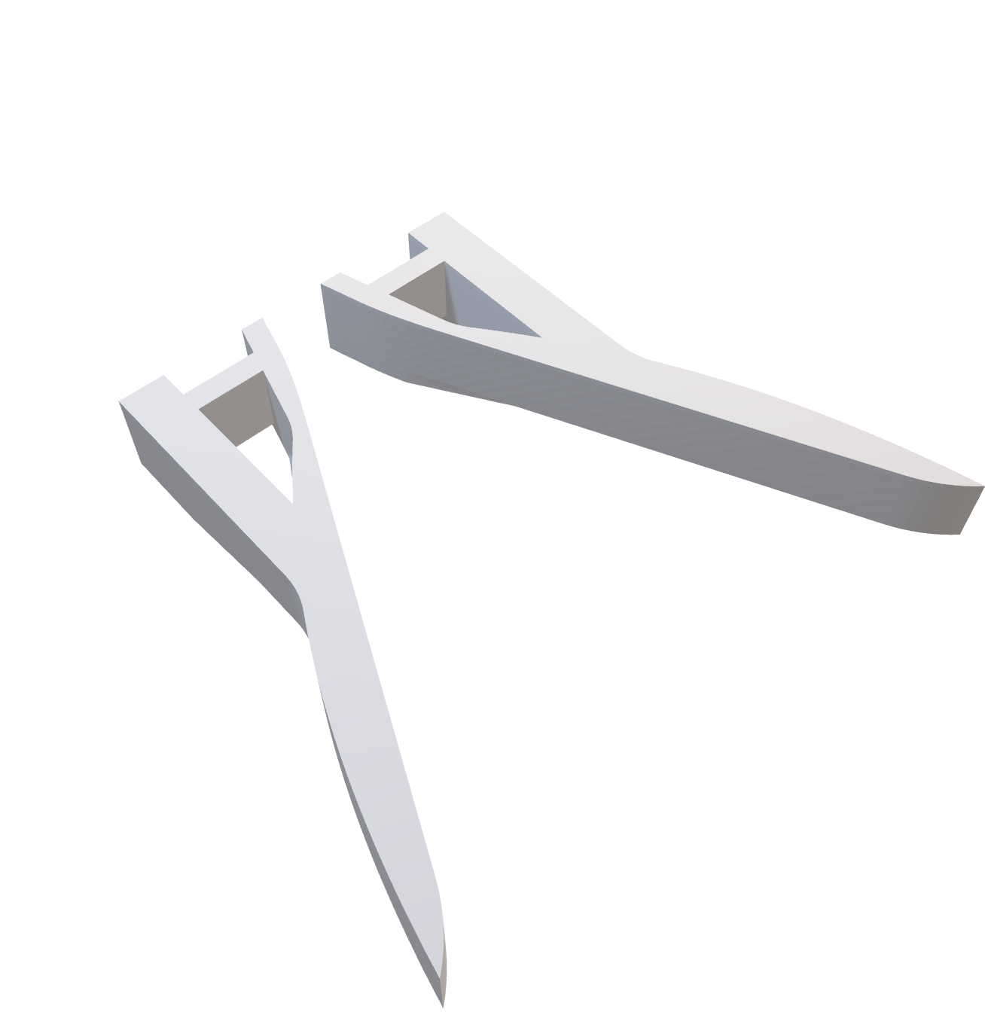
Funnel
Size
Too wide
Opening angle
Slim it down

Slide 25
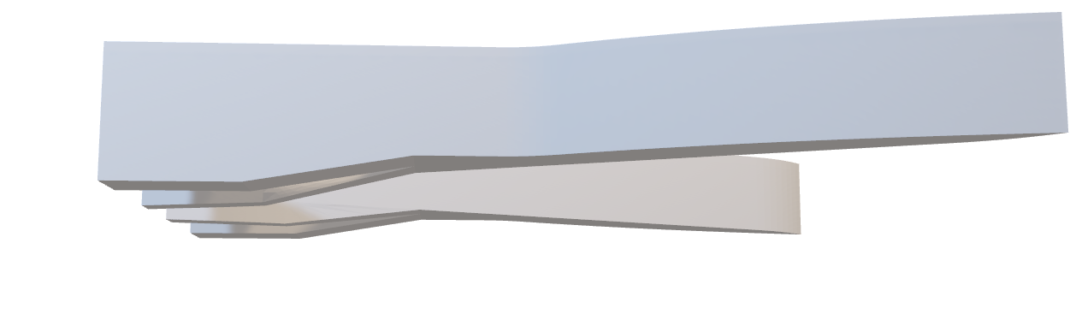
Funnel
Size
Too wide
Friction
Avoid friction by lifting front
Opening angle
Slim it down

Slide 26
Detection and Movement

Slide 27


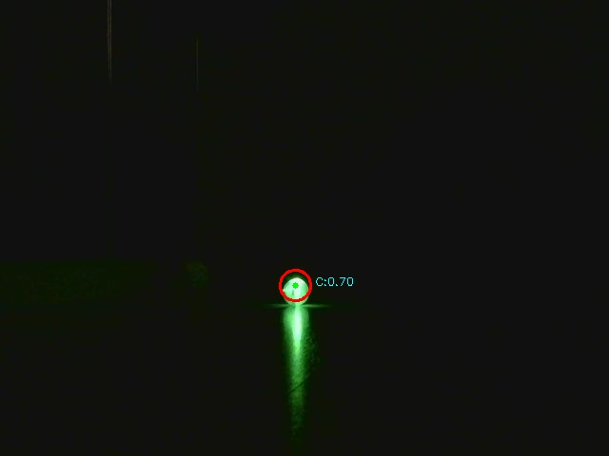
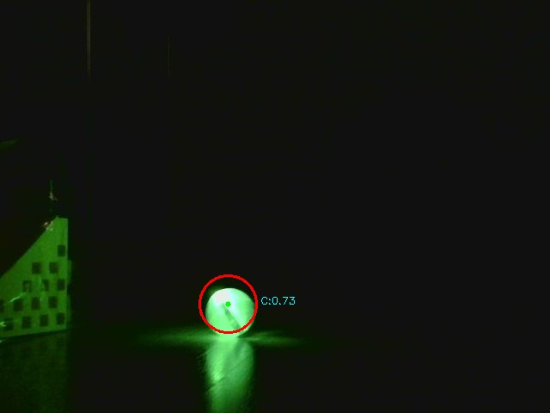
Blob Detection
Filter for bright spots
Check for circularity
Filter non-circular blobs
Choose light blobs that best match color
Isn’t perfect

Slide 28
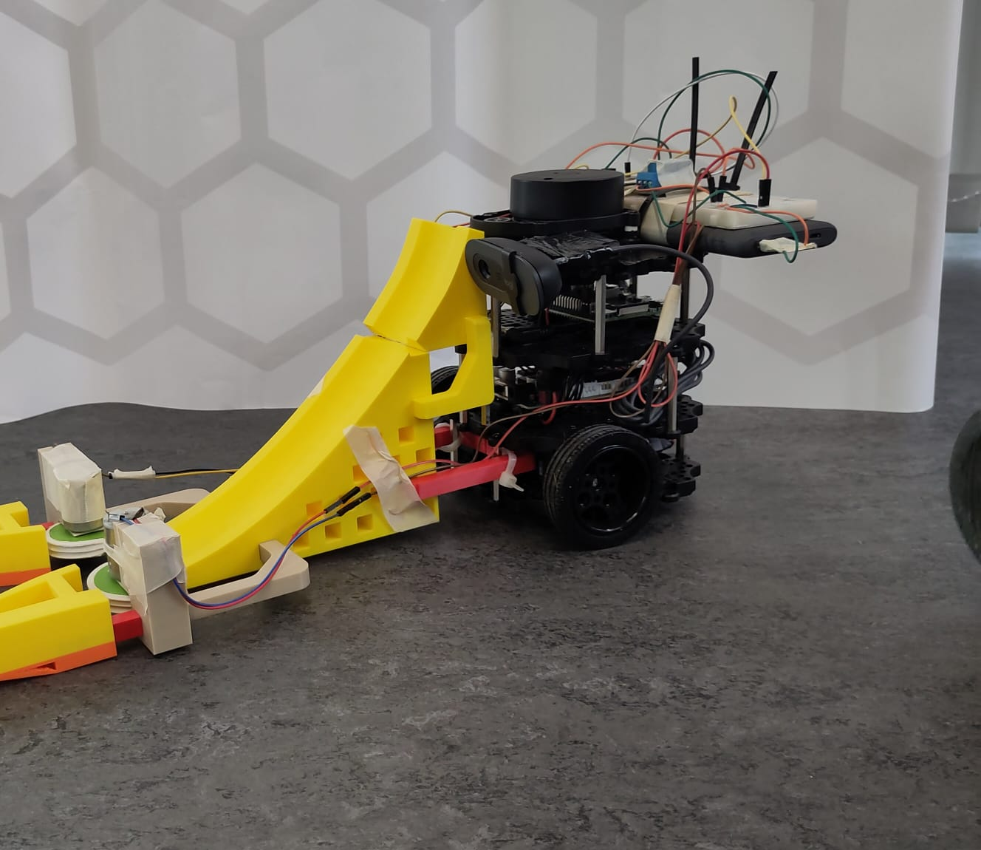
Blob Detection
USB-camera mounted on Turtlebot3
Added system startup file to remove auto lighting settings in USB-camera

Slide 29

Turtlebot Movement
after(2s)
after(20s)
blobDetected
blobCentered
belowYThreshold
blobLost

Slide 30
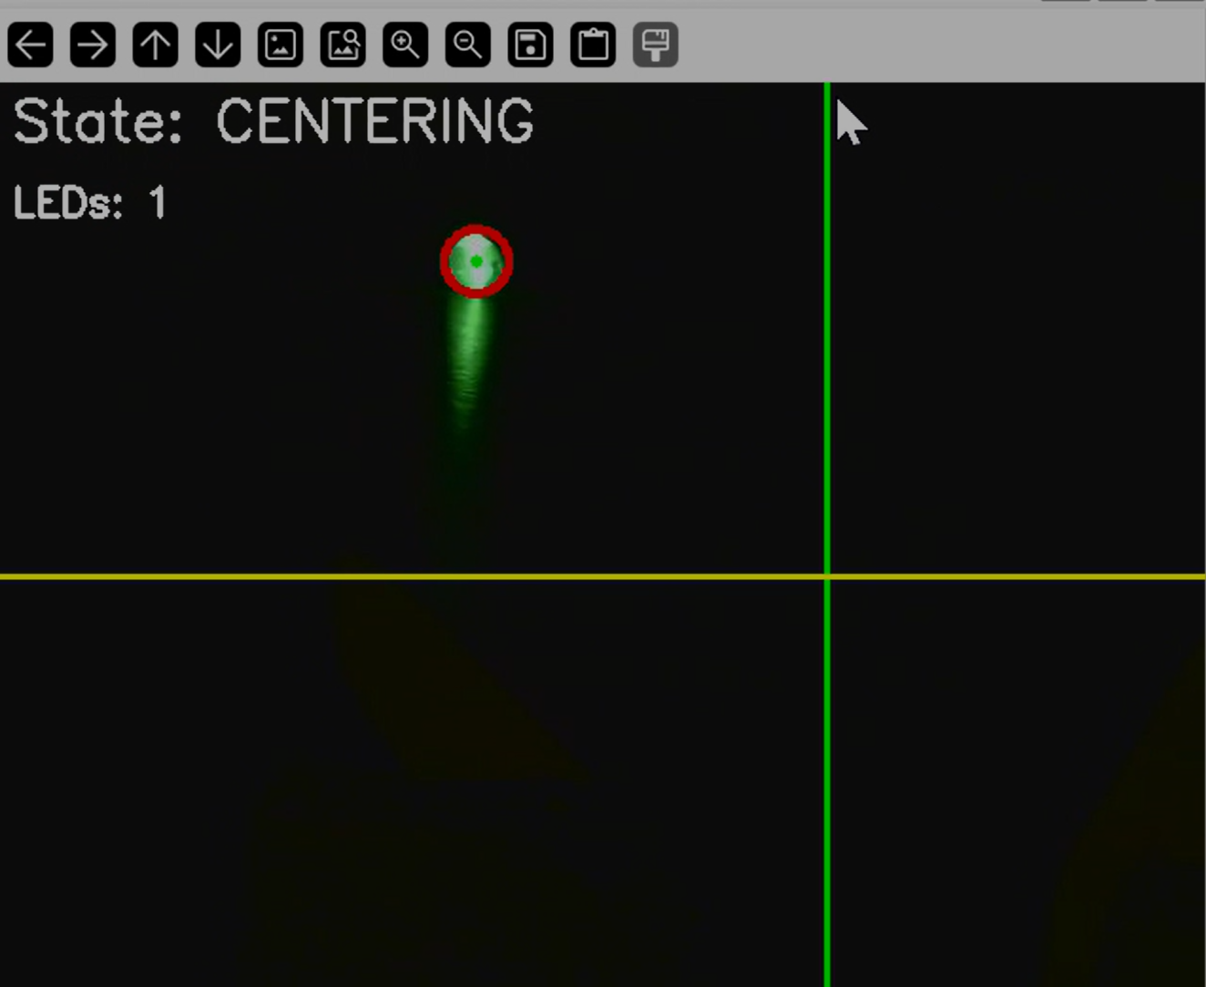
Turtlebot Movement - Centering
Offset Centering X-Line
Y-Collection Threshold

Slide 31
combined

Slide 32
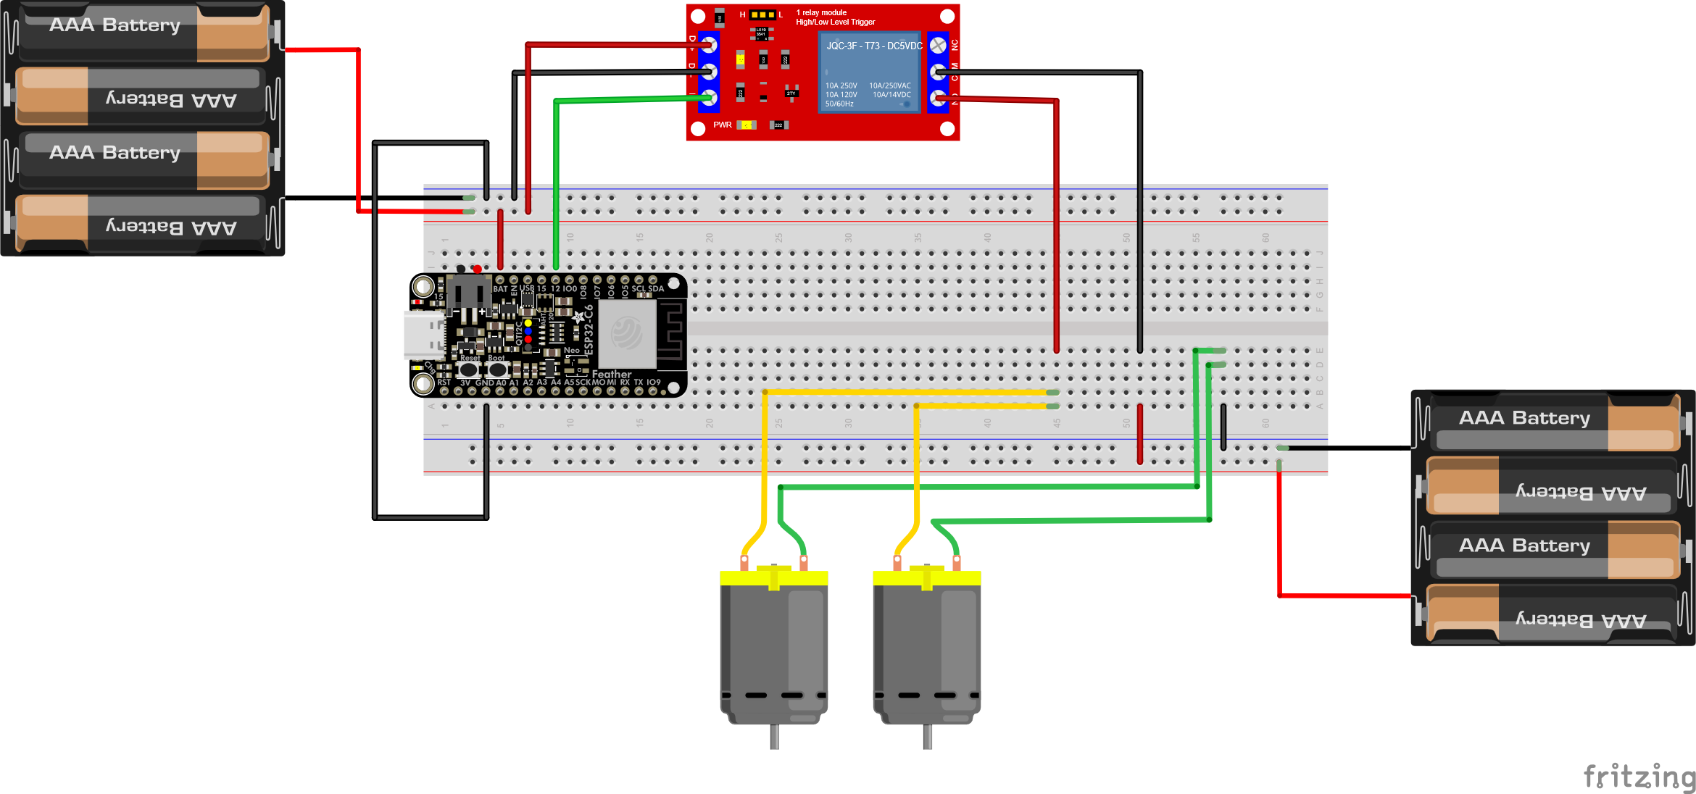
Circuit

Slide 33
Schema

Slide 34
Assumptions and Limitations

Slide 35
Assumptions and Limitations
No other strong light source than LED
Larger spatial area
Difficulty with small obstacles

Slide 36
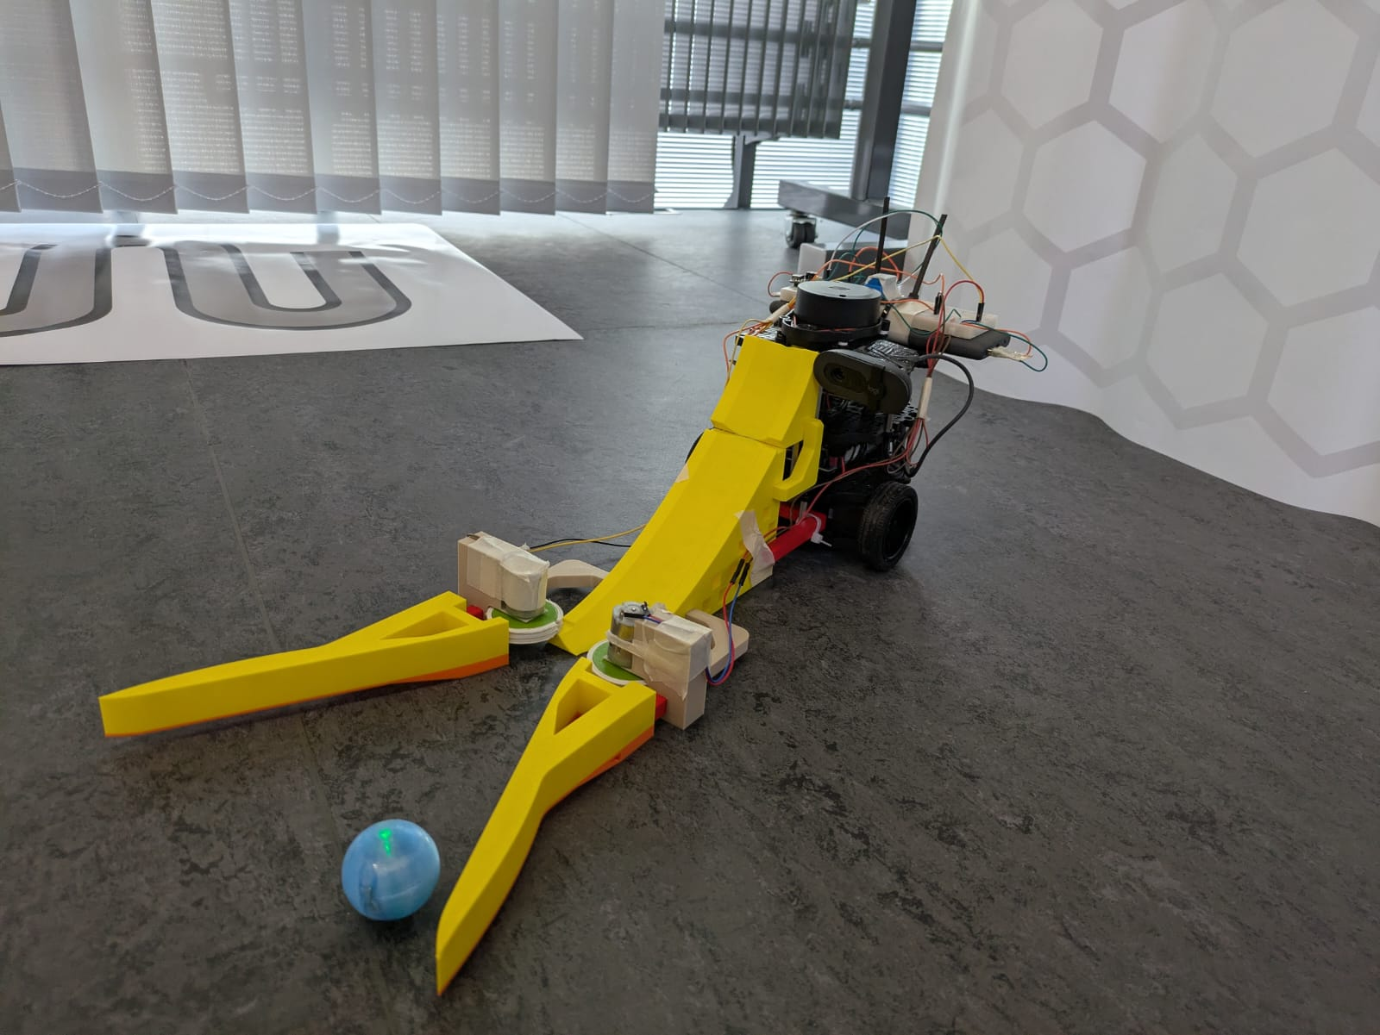

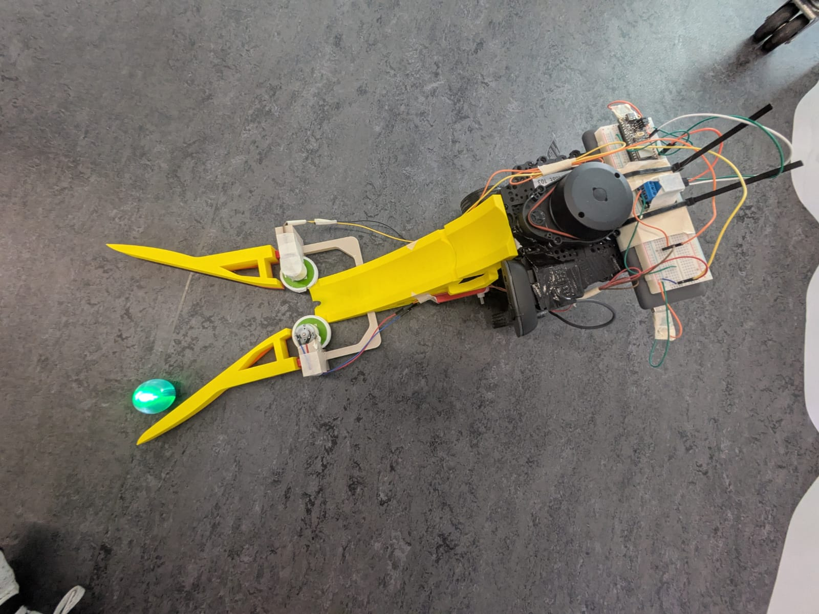
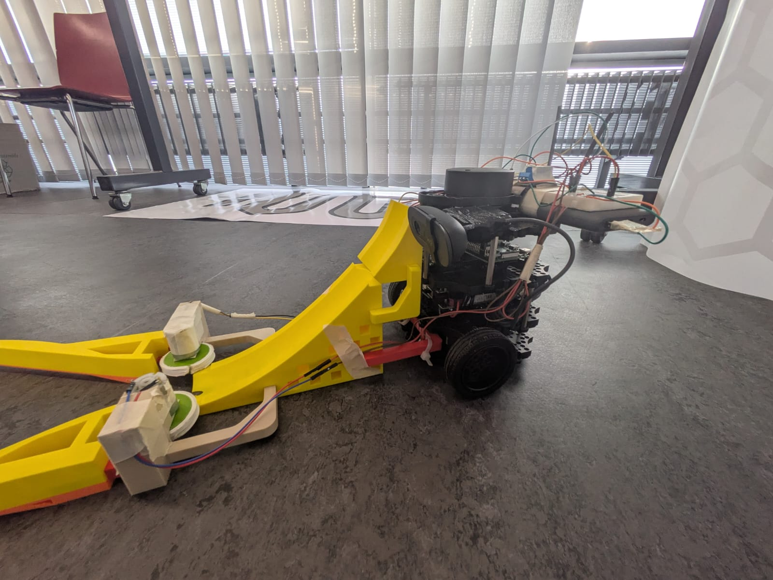
Final Outcome

Slide 37
Final Outcome

Slide 38
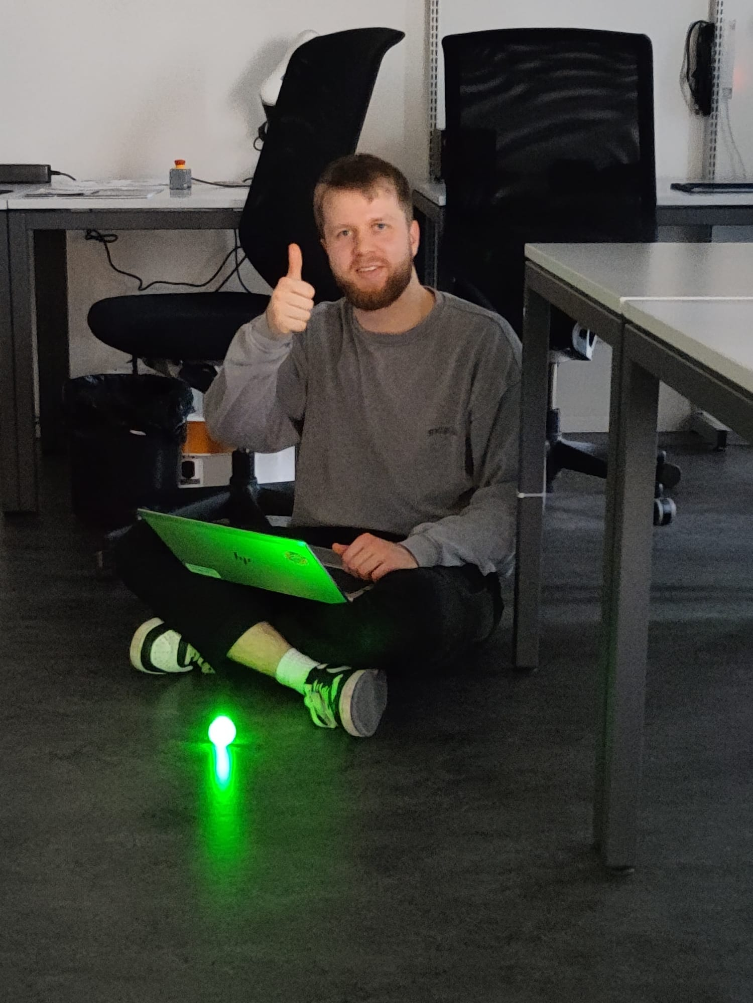
The End
Any Questions?

